Slide 1
Language, Style, Figures and Tables Session 08
Course : COMP6575 – Research Topics in Computer Science
Effective Period : December 2019

Slide 2
Learning Outcomes
At the end of this session, students will be able to:
LO 3: Analyze the results from the research study

Slide 3
Outline
The Scientific Style
Truth
Presentation
Scene
Cast
Thought and Language
The Goals of Using Figures
Important Goals of Using Graphics for Communication in a Scientific Publication
Error in Graphs
Tables

Slide 4
Language and Style

Slide 5
The Scientific Style
According to Thomas and Turner, a writing style is defined by the stand taken on 5 issues:
Truth
Presentation
Scene
Cast
Thought and Language

Slide 6
Truth
The scientific style assumes a universal and objective reality that exists independent of the writer or reader
There is a truth concerning this reality, but it is not manifest
It takes hard work to get close to this truth, and in the end we can only comment on the accuracy of our scientific models, not their correctness in some absolute sense.
The truth is independent of both writer and reader
Scientific knowledge is not invented or created, it is discovered.
Then after it is discovered, it is verified by other scientists.

Slide 7
Presentation
In the scientific style, the most valued attributes are accuracy, precision, clarity, concision, and grace (int that order)
Accuracy means that all new knowledge claims are justified and verifiable
The point of research is to claim new knowledge
Claiming too little gives question to the value of the paper
Claiming too much gives question to the competence or integrity of the author
Precise means that the meaning understood by the reader matcher the meaning intended by the writer

Slide 8
Scene
The imagined scene for communicating between author and reader is a presentation at a scientific meeting
The audience is there because they are interested in your topic, and they will save their questions until the end.
Our job is to teach the audience what you learned in the course of your investigations.

Slide 9
Cast
Your readers are like the audience of your imagined symposium talk
They are interested in your topic and generally familiar with this field.
They are enthusiastic graduate students and experienced veterans
They are intelligent and willing to put the effort into understanding what you have to say, but only if you make it worth their while.

Slide 10
Thought and Language
There are no thoughts in the writer’s head that cannot be adequately expressed and understood with the right choice of words.
Language (including mathematics notation) is fully up to the task of representing even the most complex concepts with accuracy and precision.

Slide 11
Figures and Tables

Slide 12
Figures

Slide 13
The Goals of Using Figures
As a form of communication, figures (and in particular, the graphical display of quantitative data) are uniquely suited to conveying information from complex data sets quickly and effectively.
Graphs take advantage of the magnificent power of the human brain to recognize visual/spatial pattern and to quickly change focus from the big picture to small details.
Graphs are extremely popular in scientific literature for the simple reason that they work so well.
But like all the forms of communication, graphics can be used to explain and clarify but also to confuse or deceive.

Slide 14
Important Goals of Using Graphics for Communication in a Scientific Publication
Document the data (a graph is often the only place the data get published)
Make comparisons (Such as displaying trends)
Allow for inferences of cause and effect
Tell a story, or at least be an integral part of the tale; and
Integrate with the text to enhance the overall communication of the paper

Slide 15
Graphs
The design of the graph it self should be driven by the structure in the data and what story the data have to tell
However, between allowing the data to speak for themselves and forcing the story you want to tell.
Well presented data should encourage the consideration of alternate explanations, not just for your preferred explanation.
Overall, the process of creating a graphical display follows these basic steps:
Choose the data to be presented
Define the message to be conveyed
Pick a style of graph that supports the message
Construct the graph seeking clarity
Revise it until it is right

Slide 16
Error in Graphs
According to William S. Cleveland that 30% of all graphs published in volume 207 of science contained errors.
The error types he found were classified as mistakes of construction
[6%] Mislabels, wrong tick marks or scales and missing item
[6%] Poor reproduction (with some aspect of the graph missing as a result)
[10%] Poor discrimination (items such as symbol types and line styles could not be distinguished)
[15%] Poor explanation (Something on the graph is not explained, neither in the caption nor the text)

Slide 17
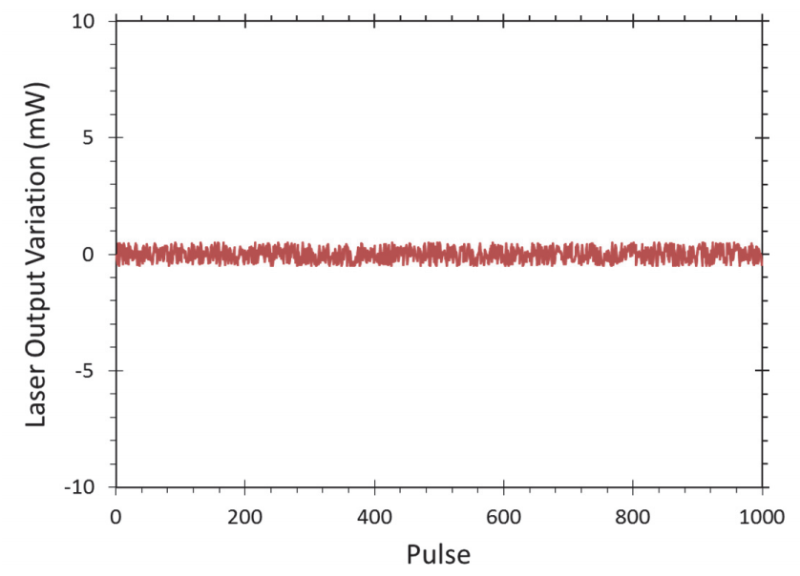
Examples
A wasted graph
The y axis is chosen to give the impression that there is little variation in the output, but if we cannot see any variation in the data, why show the graph?

Slide 18
Tables

Slide 19
Tables
Tables present data directly and are preferred over graphs when the exact numerical values of the data are needed
Still, tables often have a goal similar to that for figures: enabling comparison
As with figures, tables should be made comprehensible on their own, without reference to the text of the paper, if possible
Table should have a good caption, and the items presented should be clearly defined within the table
Do not forget units and uncertainty estimates

Slide 20
References
Chris A. Mack. (2018). How to Write a Good Scientific Paper. Society of Photo-Optical Instrumentation Engineers (SPIE). ISBN: 978-1-5106-1913-5

Slide 21
In Class Assignment

Slide 22
List all details of your graphs and figures, discuss it with your lecturer!

Slide 23
Thank you

